Slide 1
Twitter Airline Sentiment Analysis
Web and Social Analytics Course Project
Group 3
•Rafia Fasih
•Varun Milind Joshi
• Safoora Naureen
• Rishitha Reddy Chinnareddy gari

Slide 2
Introduction and Business Context
•In the age of social media, understanding public sentiment is invaluable.
•Twitter, as a microblogging platform, provides a rich source for sentiment analysis.
•The airline sector relies heavily on advanced sentiment analysis for real-time monitoring of passenger comments.
•This dependence is crucial for enhancing customer experience and effective crisis management.
•The strategic use of sentiment analysis techniques is pivotal for airlines to maintain a competitive edge in the dynamic and competitive industry landscape.

Slide 3






Problem Statement & Objective
Problem Statement
Objectives
Objectives
Conduct Comprehensive Exploratory Data Analysis (EDA):
Perform in-depth EDA on the dataset to uncover patterns, trends, and correlations between sentiment, geographic variations, and temporal metrics.
Implement Sentiment Analysis:
Develop and implement sentiment analysis techniques for real-time monitoring of passenger comments on social media platforms.
Limited Real-Time Insight: The airline industry faces challenges in gaining real-time insights into passenger sentiments, hindering the ability to promptly address concerns and capitalize on positive feedback

Slide 4
What does it mean for Business?
Crisis Preparedness: sentiment analysis as a tool for helping airlines anticipate & manage potential PR crises by identifying emerging negative sentiments & allowing for timely and effective communication strategies.
Operational Efficiency: Understanding customer sentiments allows airlines to optimize their operations by identifying main points and streamlining processes, leading to increased operational efficiency and cost-effectiveness.
06
01
Data-Driven Decision-Making: Support business decisions with quantitative insights from sentiment analysis for continuous improvement and innovation.
Brand Reputation Management: Actively manage and respond to sentiments on social media for maintaining a positive public image.
05
02
04
03
Customer Experience Enhancement: Performing sentiment analysis on airline tweets enables businesses to gain valuable insights into customer sentiments, allowing them to proactively address issues, enhance overall customer experience, and build loyalty.
Competitive Positioning: Leveraging sentiment analysis insights provides a competitive advantage by enabling airlines to differentiate themselves based on customer satisfaction, attracting new customers, and retaining existing ones in a highly competitive industry.

Slide 5
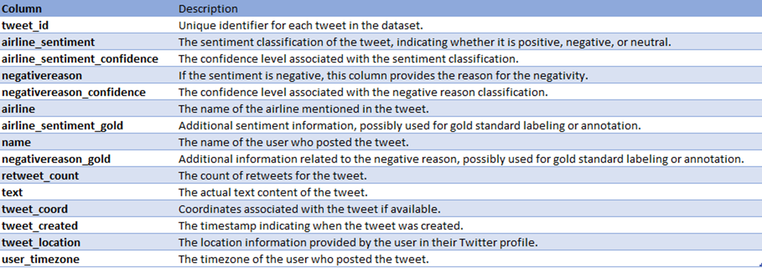
Data source-https://www.kaggle.com/datasets/crowdflower/twitter-airline-sentiment
Description- The dataset comprises tweets pertaining to airline experiences, classified into three sentiment classes: positive, negative, and neutral. It includes key information such as tweet text, sentiment labels, and details about the respective airlines. Notably, the tweets in this dataset date back to 2015, raising considerations about the relevance of sentiment analysis due to potential shifts in the airline industry's sentiments over time. It has 14640 rows and 15 columns.

Slide 6
Methodology
Data Loading
Data Exploration
Data Processing
Research Questions
Additional Categorisation
Model Building
Result & Conclusion
Csv to pandas
•Categorical & numerical columns
•Null values
•Temporal trends
•Geographic variations
•Sentiment impact
•Countvectorizer
•TFIDF
•GloVe
•Missing values

Slide 7
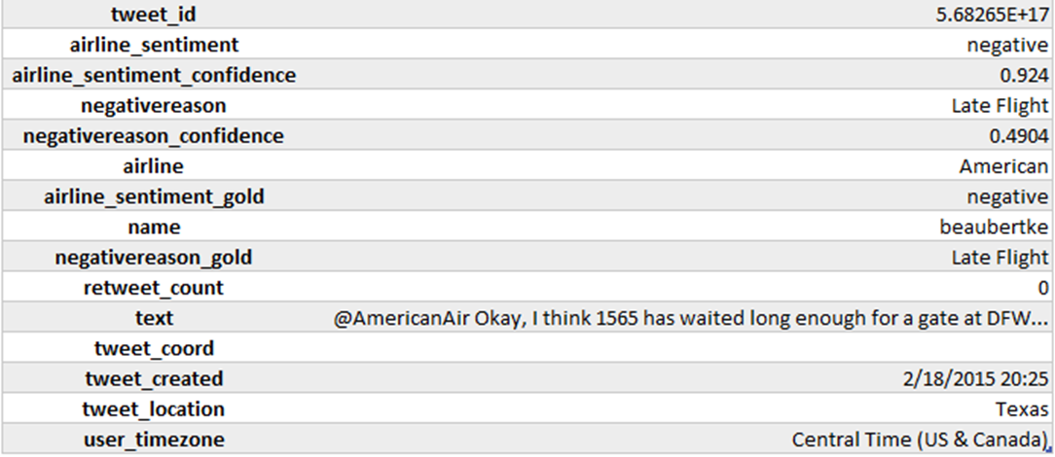
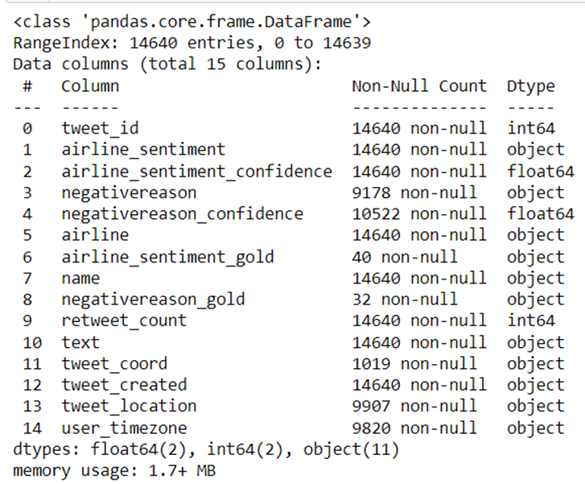
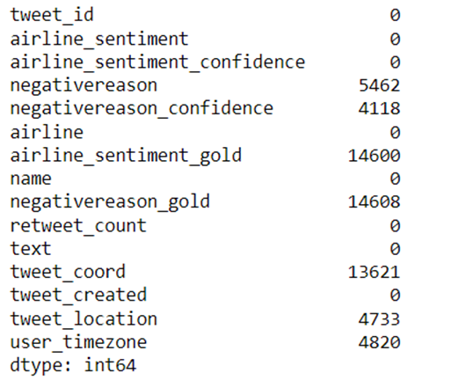
Data Snapshot

Slide 8
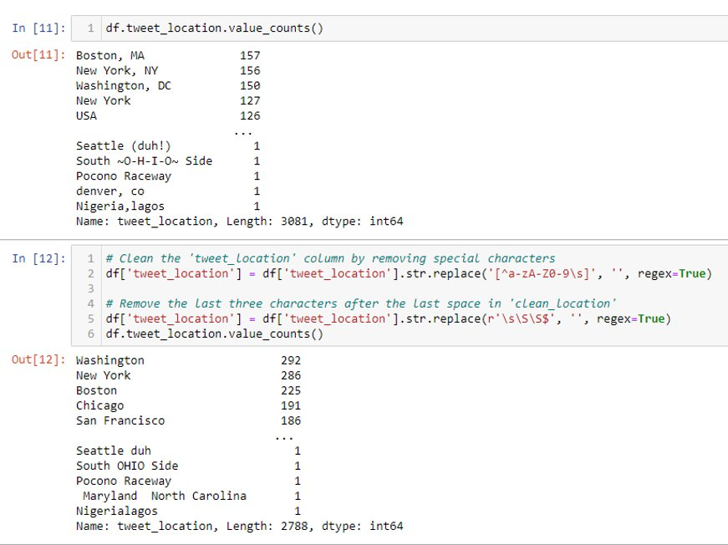
Data Processing
•Removing excess columns
•Modifying the tweet location column
•Imputing missing values for tweet_location and user_timezone with ‘Unknown’
•Getting tweet_hour and tweet_date form tweet_created column

Slide 9
Research Questions
1.Sentiment Distribution: What is the distribution of sentiment (positive, negative, neutral) within tweets discussing airline experiences?
2.Airline Performance: How do different airlines compare in terms of sentiment, revealing patterns of consistently positive or negative customer feedback?
3.Temporal Trends: Are there discernible temporal trends in sentiment, such as seasonality or evolving sentiments over time, offering insights into changing customer perceptions?
4.Key Topics: What are the predominant topics or issues highlighted in negative tweets concerning airlines, shedding light on the common concerns among customers?
5.Sentiment Impact: To what extent does sentiment correlate with key engagement factors like retweets, providing an understanding of the impact of sentiment on social media engagement?
6.Geographic Variation: Is there noticeable geographic variation in sentiment, with specific regions demonstrating more positive or negative sentiments toward airlines, offering insights into regional perceptions and experiences?

Slide 10
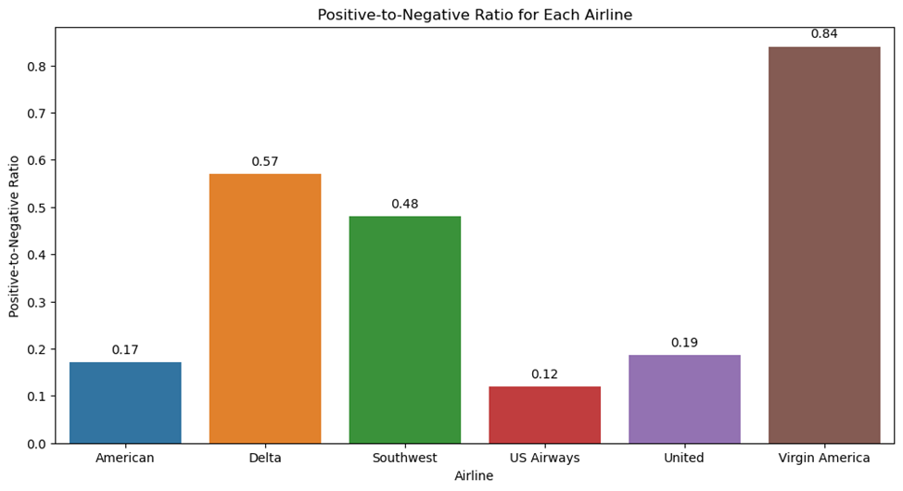
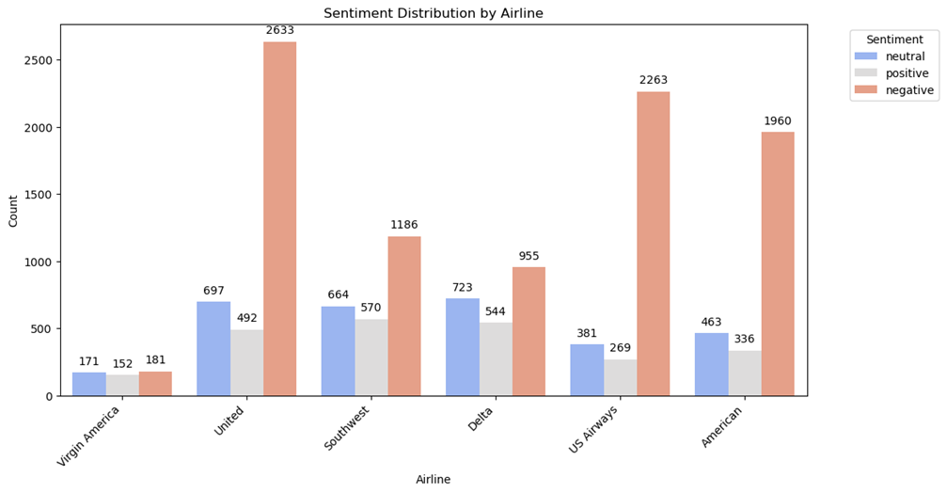

Slide 11
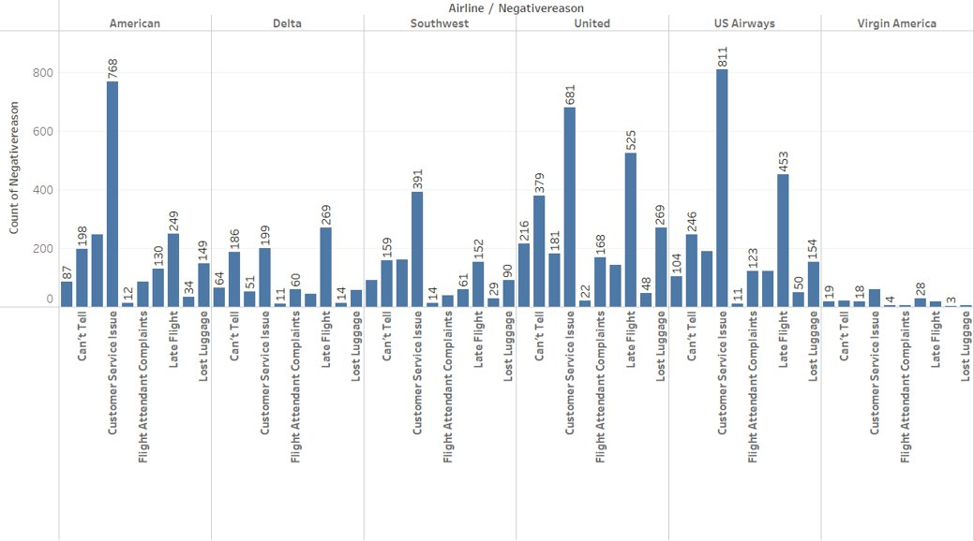
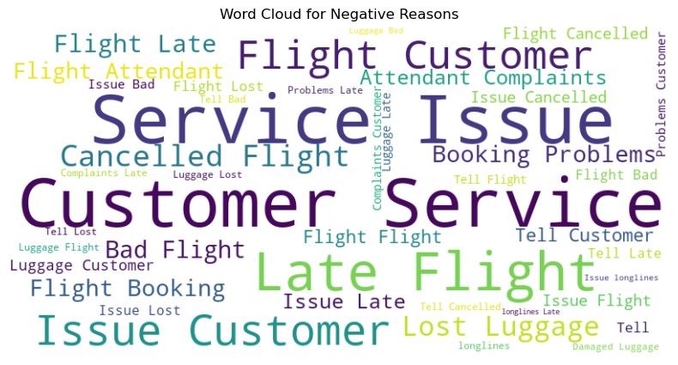

Slide 12
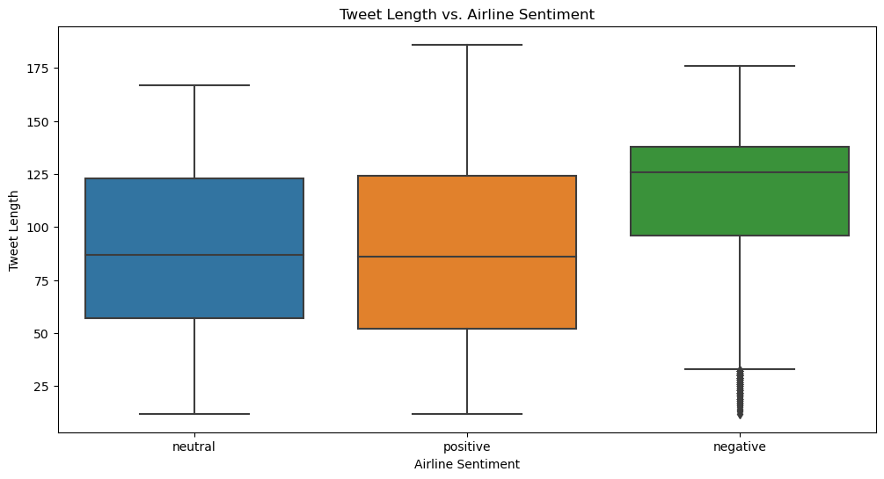
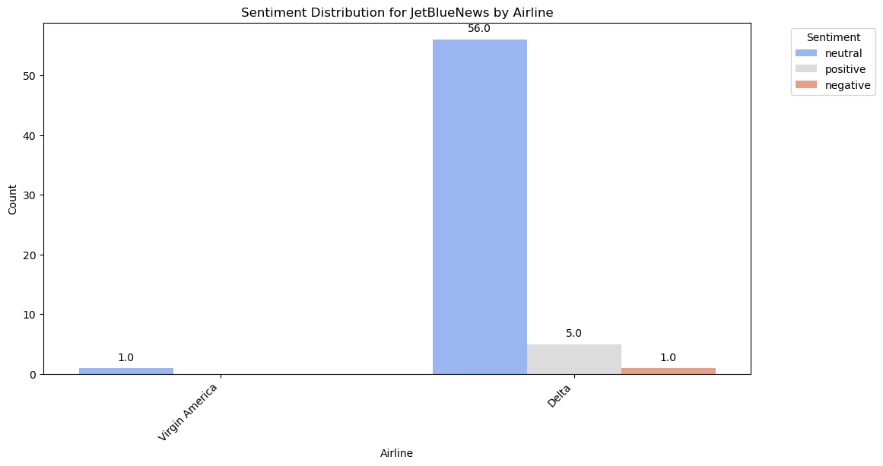
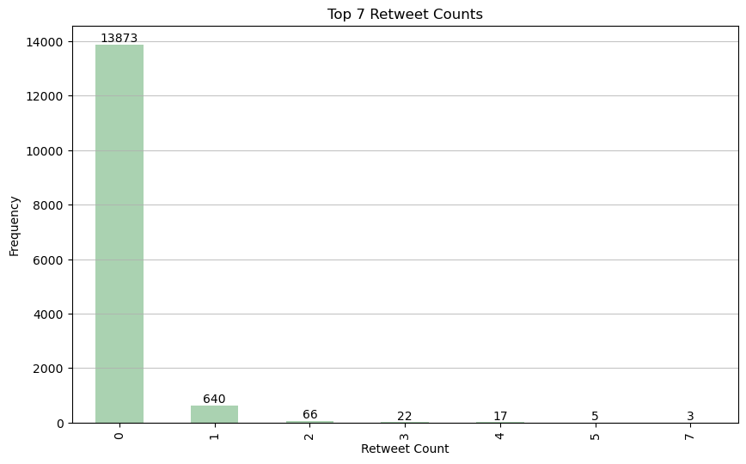

Slide 13
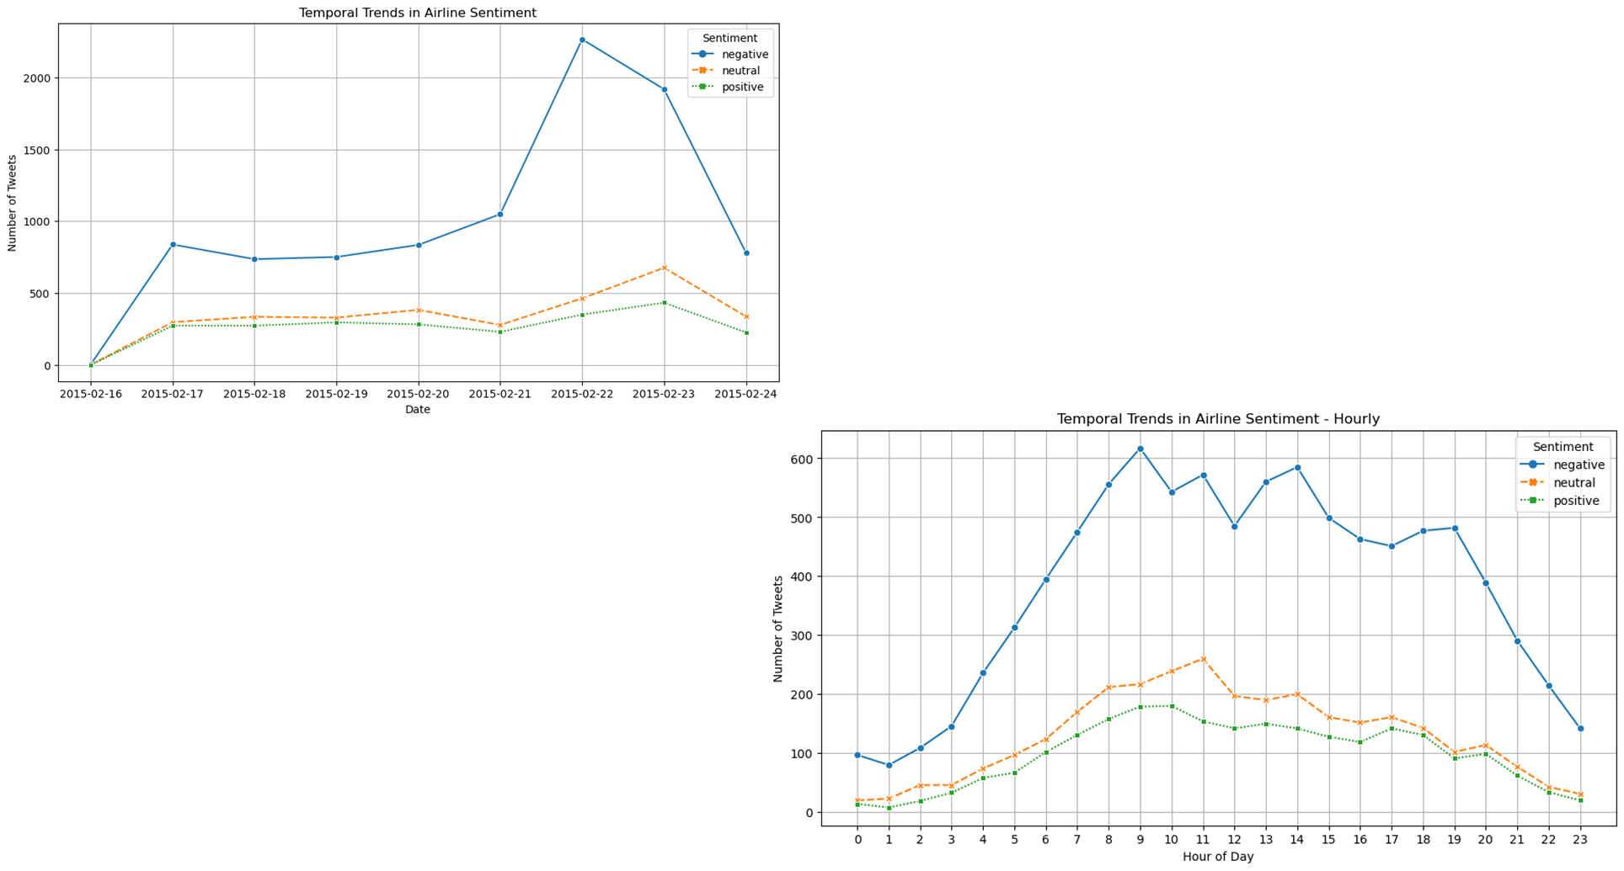
Temporal Trends

Slide 14
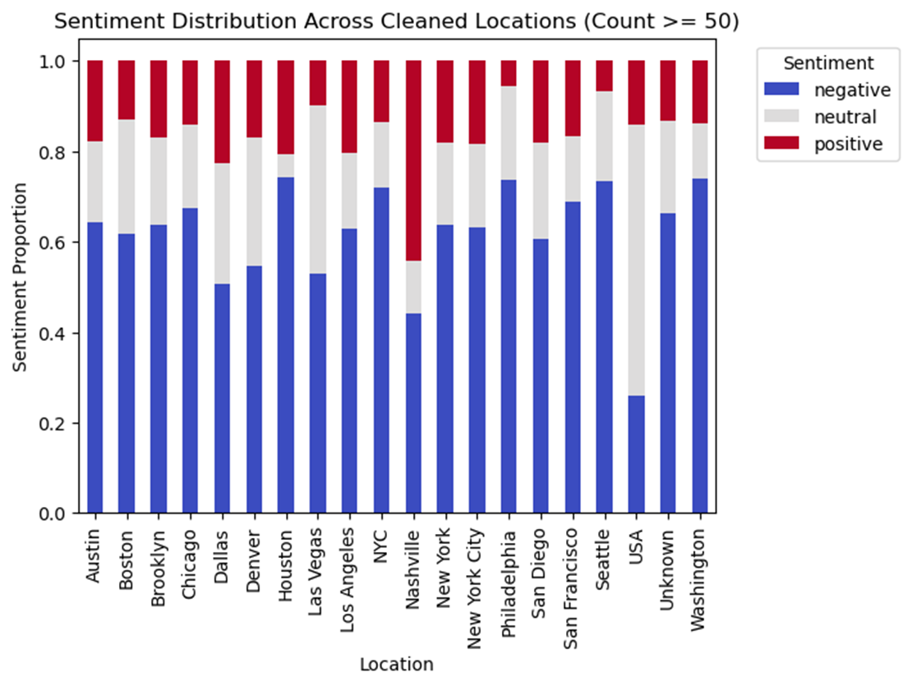
Geographic Variations

Slide 15
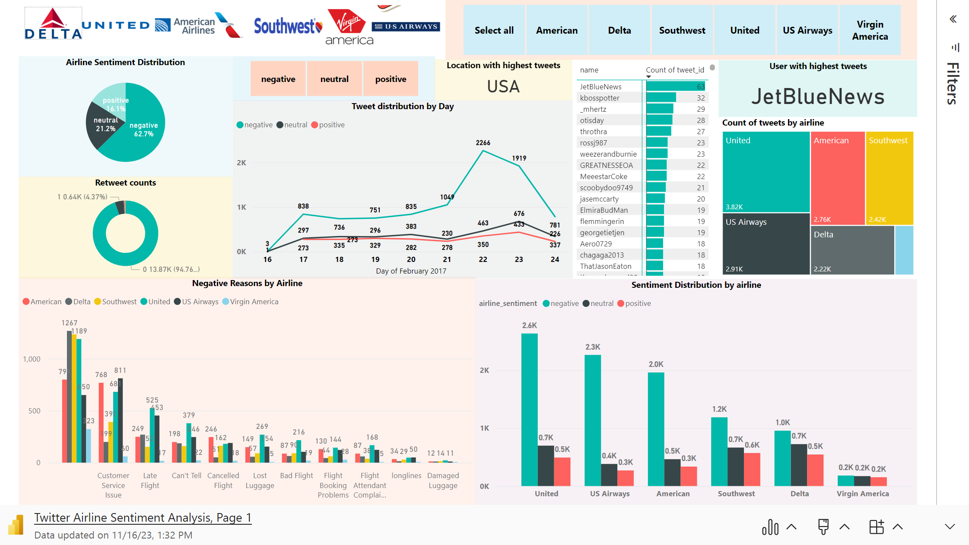

Slide 16
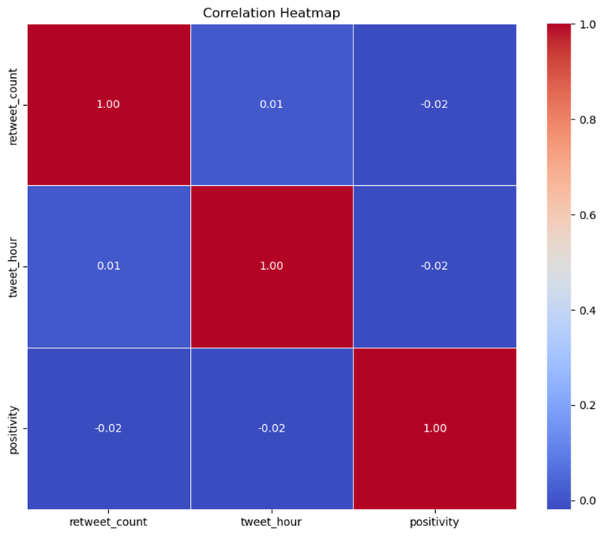
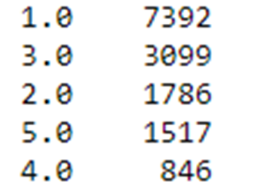
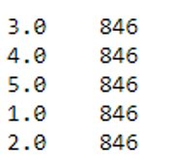
Categorisation & Sentiment Impact
•Created new column as Positivity(1 to 5) to have 5 standards rather than just the 3 (positive, negative, neutral) using confidence level
•Balanced the dataset to have equal distribution of positivity
•Conducted correlation analysis of positivity and other numerical columns

Slide 17
Model building for Sentimental Analysis
Remove Stop words
NLP Methods
Performance Metrics
SVM
C=1
Kernel:rbf
Count vectoriser:62.1%
TFIDF: 61.8%
GloVe:62.4%
Confusion matrix
Splitting the dataset (80:20)
Grid search and Cross Validation
Prediction

Slide 18
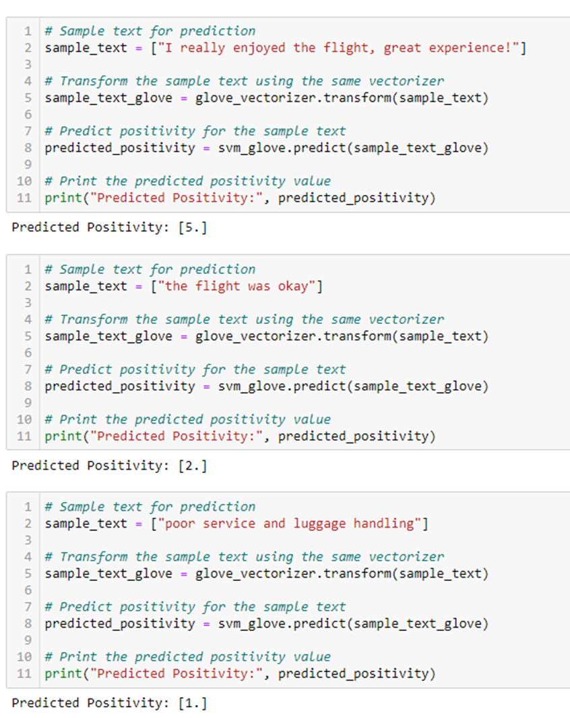
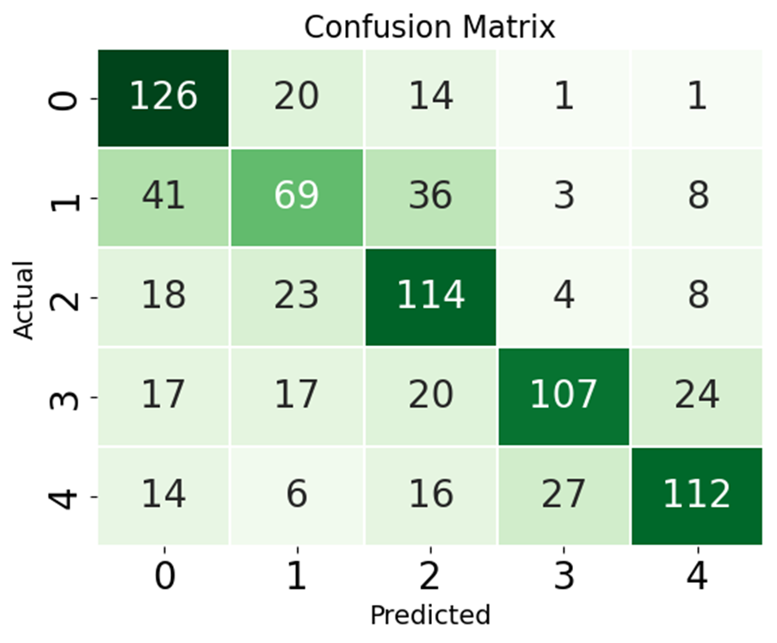

Slide 19
Conclusions & Recommendations
•Dominance of Negative Sentiments: Individuals expressing their opinions online, particularly on platforms like Twitter, tend to share negative reviews more frequently than neutral or positive ones.
•Negative sentiment ratio is higher for US Airways and American Airlines despite the higher count for United Airlines
•Enhancing positive sentiments can be leveraged for marketing and brand-building
•Addressing negative sentiments in real-time can lead to improved customer satisfaction and loyalty.
•Limitations: The data is of 2015 which cannot be applicable in the Post COVID Era; Balanced dataset also limited the size of it in entirety.
•Recommendations: Based on our findings, airlines should actively engage with customers on social media, promptly addressing concerns and showcasing positive experiences. Utilizing the developed real-time sentiment analysis tool can enhance targeted marketing efforts, leading to an improved brand perception.

